Slide 1

Project Name: Tech Layoff 2022
Project Link : Tech Layoff 2022
Created by : Yash Gode

Slide 2
Project Description
Big companies and organizations are facing problems and many of them are laying off their employees in response to that. There are multiple reasons, varying from company to company.
This Dataset Consists of list IT EMPLOYEES THAT HAVE LAID off BY THE top companies in YEAR 2022.

Slide 3
List of KPI’s
Companies layoff by size
Year wise layoff
Month wise layoff
Company foundation by layoff

Slide 4
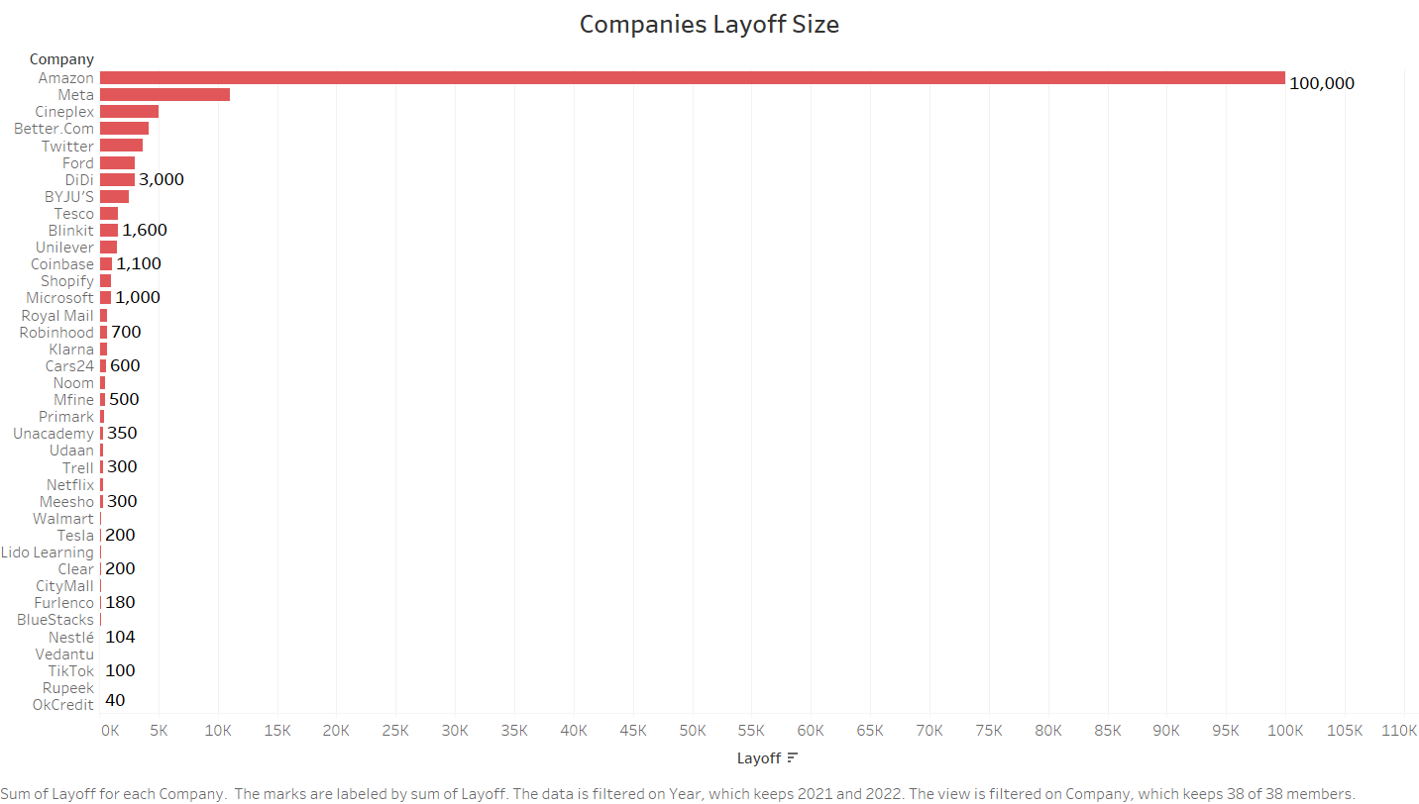
As we can see in the above bar graph Amazon company has laid off maximum employees i.e., 1,00,000 employees were laid off.
The OkCredit company has laid off minimum number of employees i.e, 40 employees were laid off.

Slide 5
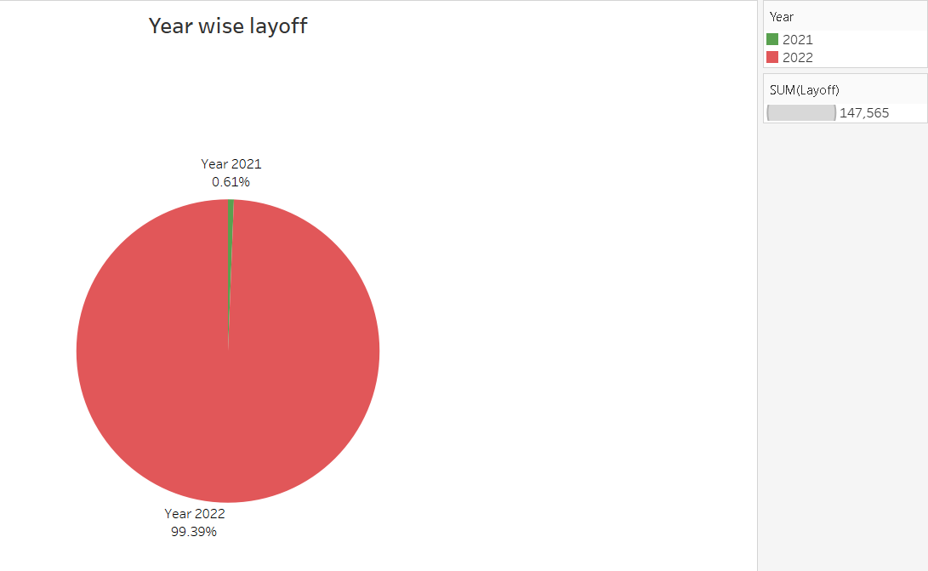
From the above pie diagram it is seen that the employee laid off rate is maximum in year 2022. i.e, 99.39% and only 1% employees are laid off in the previous year 2021.

Slide 6
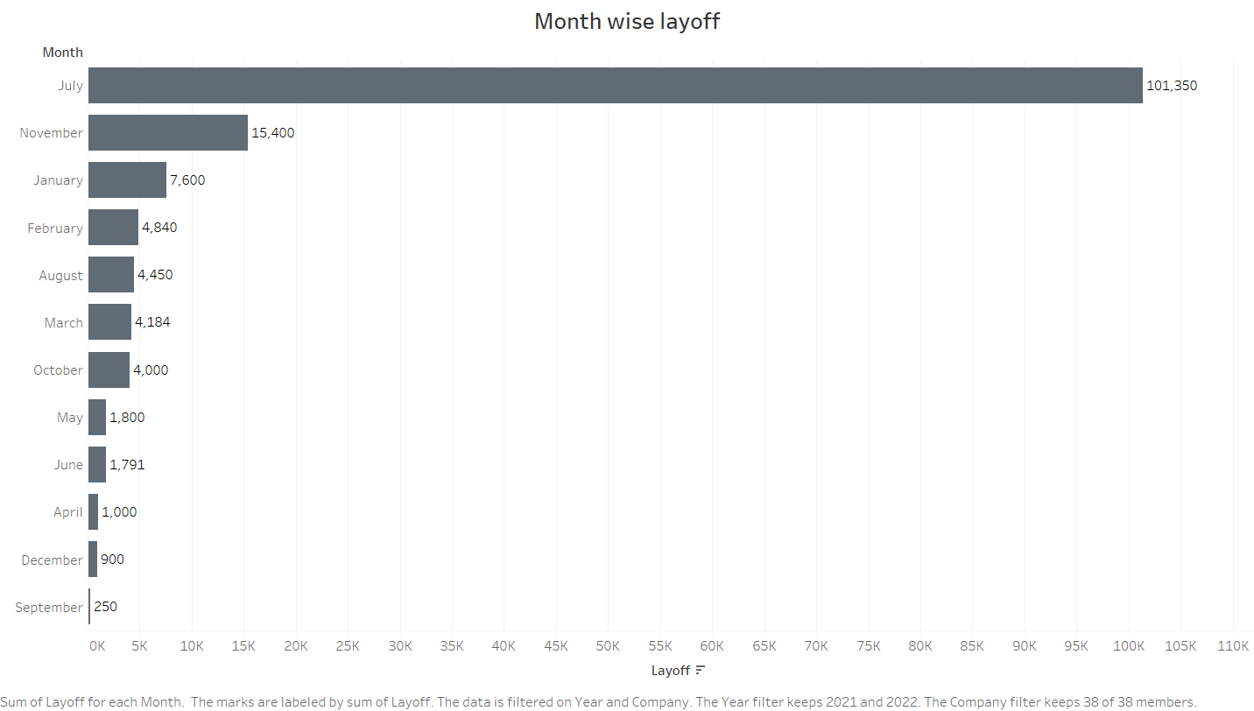
From the above bar graph it is seen that the total employees that have been laid off segregated in to different months.
So, the maximum employees are laid off in the month of July I.e, 1,01,350 and the minimum employees were laid off in the month of September i.e, 250.

Slide 7
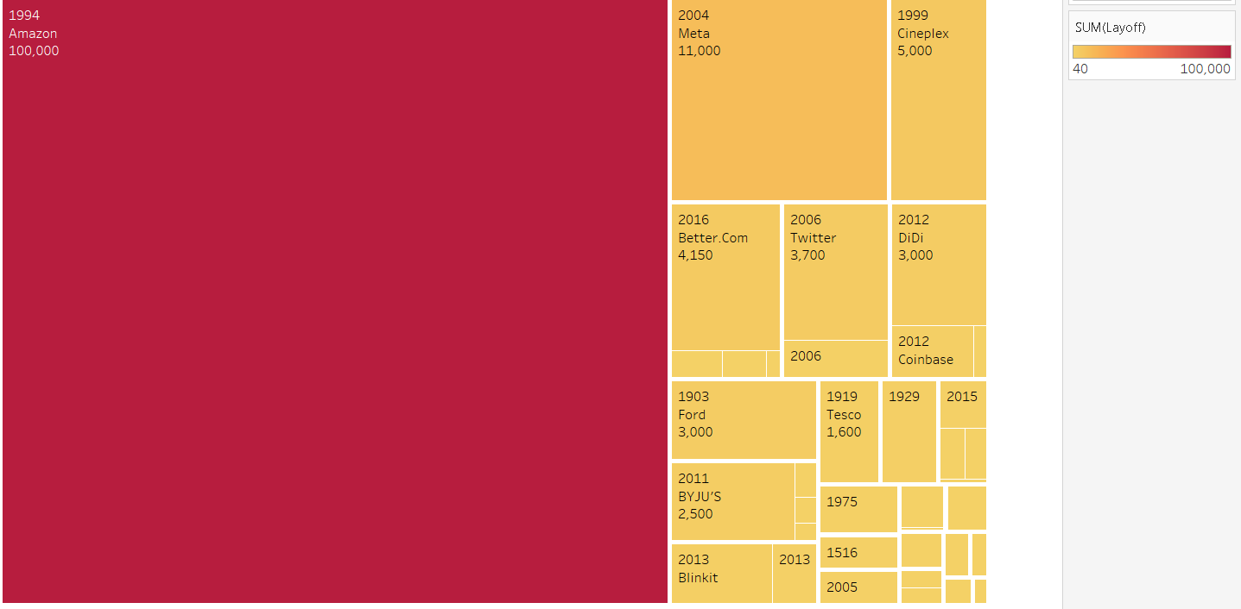
The Above treemap graph shows the company name, its founded year and the number of employees it has laid off.
As we can see the field which is shown in dark red which is Amazon having maximum layoffs and it is founded in the year 1994.

Slide 8
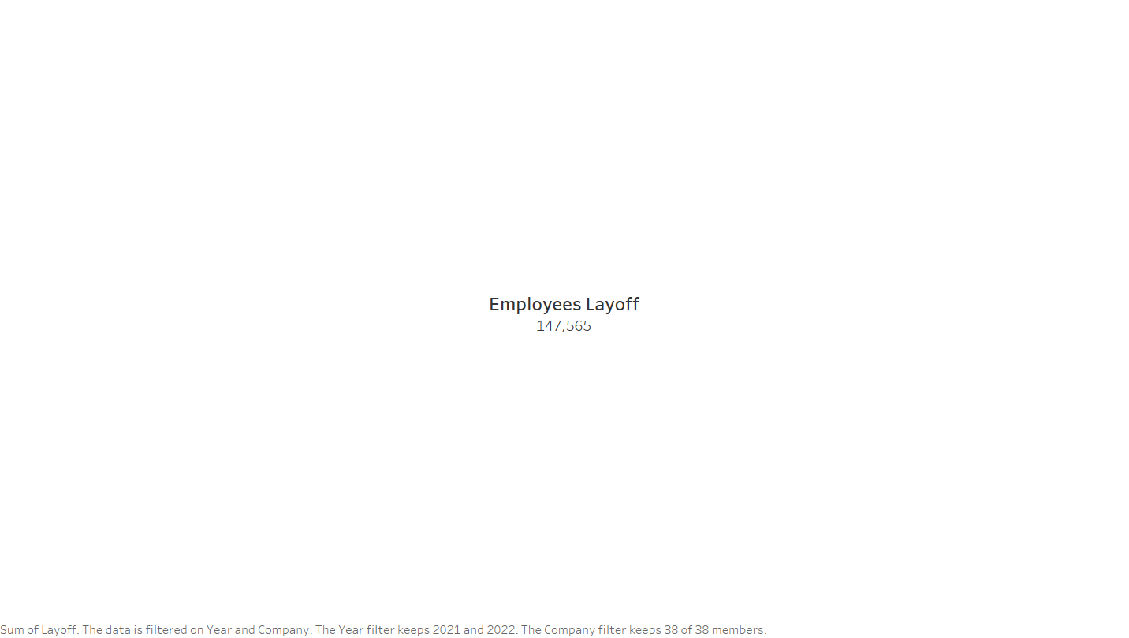
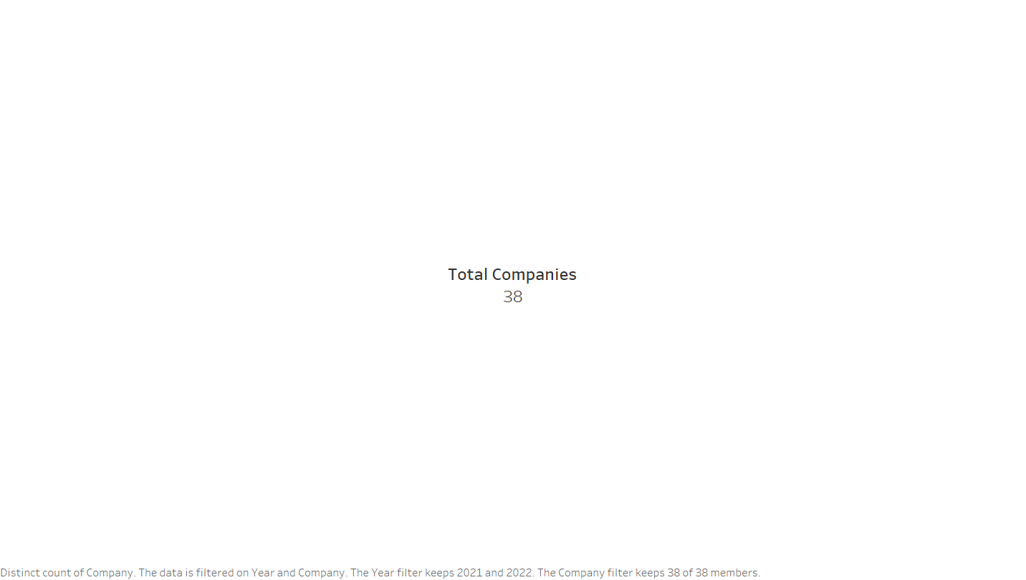
The above figure shows the total number of employees that are laid off by the top companies.
So, there are overall 38 companies and it has laid off 1,47,565 employees in the year 2022.
The employee laid off rate is very high as compared to the previous year.

Slide 9
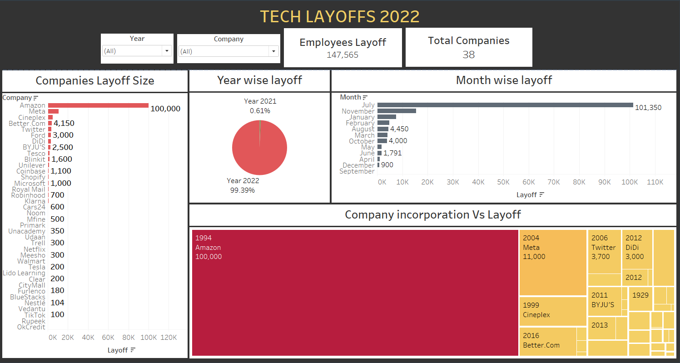
TECH LAYOFF 2022 DASHBOARD

